Slide 1
Sample problems

Slide 2
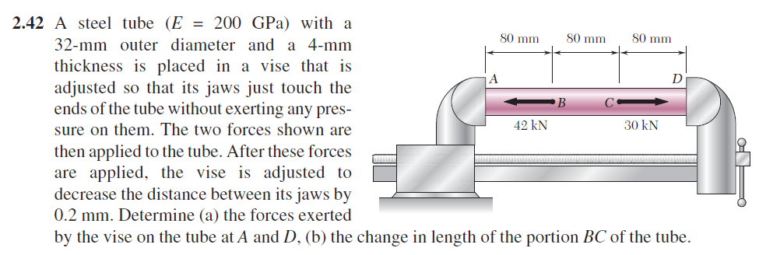
Problem 1
We will be looking at this practical problem both in terms of strict analysis and physical intuition

Slide 3
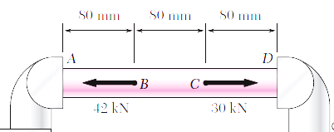
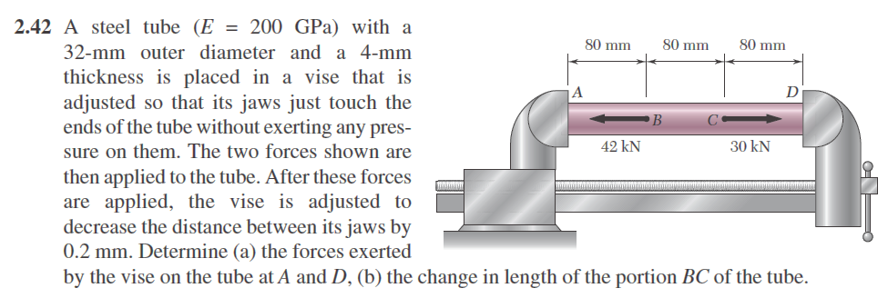
Problem 1
Vise before tightening
Vise after tightening (exaggerated)

Slide 4
Problem 1
The tube is now 80x3-0.2 mm i.e. 239.8 mm
A remains as it is
D moves to the left by 0.2 mm
B and C also move but not necessarily 0.2 mm

Slide 5
Problem 1
Let us draw the FBD
Origin is at A
Positive is from A to B
x
R_{A}
R_{A}
R_{B}
R_{B}

Slide 6
Problem 1
We have intentionally drawn the FBD of the vise also. There are two reasons for this
We will have a clear idea of what is happening overall. For instance for the jaw at A there is a fixed joint and hence a force and a moment. At B there is a sliding joint which however can becomes effectively fixed by tightening the handle and hence also a force and a moment reaction.
x
R_{A}
R_{A}
R_{B}
R_{B}
R_{A}
R_{B}

Slide 7
Problem 1
Second reason – it will help us understand the next problem better.
We will be able to understand how a system with multiple components push and pull each other during such a process
x
R_{A}
R_{A}
R_{B}
R_{B}
R_{A}
R_{B}

Slide 8
Problem 1
Marking out the critical points or domain boundaries
Critical points are A, B, C and D
At A there is a constraint
At B there is a new force, at C there is another new force
At D there is a constraint
Since there is no change in cross section or material there are no other critical points.
x
R_{A}
R_{B}

Slide 9
Problem 1
From the FBD of the tube We get
x
R_{A}
R_{A}
R_{B}
R_{B}
R_{A}
R_{B}

Slide 10
Problem 1
Domain AB
Please note We am introducing a new variable ξ in place of x we used earlier under the integral sign. If we get used to this now, we will be able to handle problems of distributed loading, specially in beam deflection problems later in this course, better.
x
R_{A}
F(x)
R_{B}

Slide 11
Problem 1
Domain BC
Note that the unit of force is kN, of length is mm and of E is GPa.
Hence unit of stress is kN/mm^2= 10^9 N/mm^2=1GPa. Hence there are no inconsistencies in units. Otherwise We MUST put in numerical values with proper units and find the units of unknown variables.
x
R_{A}
F(x)
R_{B}

Slide 12
Problem 1
Domain CD
x
R_{A}
R_{B}
F(x)

Slide 13
Problem 1
Now we are in a situation to find the displacement of B
x
R_{A}
R_{B}
F(x)

Slide 14
Problem 1
To find the change in length of the segment BC we need to find u at A and u at B, choosing the proper expressions
For u at B, we can use expressions for either domain AB or BC, since B is common to both. We choose AB since it is a simpler expression.
For u at C, we can use expressions for either domain BC or CD, since C is common to both. We have chosen to use BC.

Slide 15
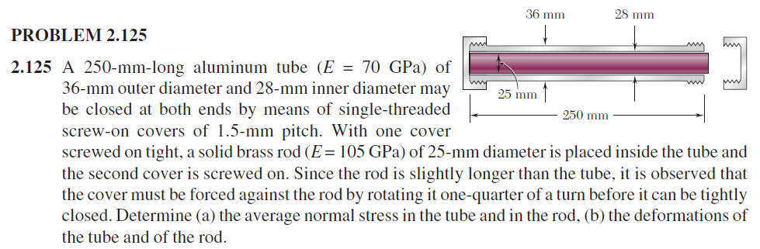
Problem 2

Slide 16
Problem 2
Let us look at the stages of deformation
Initial
Cap just tightened
No deformation
No force

Slide 17
Problem 2
Cap just tightened
Cap tightened ¼ turn
Rod must shorten, otherwise it will penetrate the cap

Slide 18
Problem 2
Cap tightened ¼ turn
Rod must shorten
Rod is pushed by the cap
Hence the rod will now push the cap
Cap is now screwed on to the tube
Hence the cap will in turn pull the tube
So we will see a slight elongation of the tube
Ultimately the rod will not shorten as much as we thought it should, i.e., as much as the cap moves in a quarter turn. This will happen because when it pushes the cap back the tube will lengthen.

Slide 19
Problem 2
We now consider the FBDs
As this problem will involve a single external force We can afford the luxury of choosing the directions of the reactions according to my intuition.
Rod is pushed by the caps
Cap-tube combo is pushed by the rod
Lengths shown are the final lengths. We will ignore changes in radii.
F
F
250 mm + Δ_{t}
F
F
L_{r} + Δ_{r}

Slide 20
Problem 2
We consider that the initial length of the rod was L_{r} which is ~= L_{t} (250 mm) but slightly more.
This “slightly more” is not Δ_{r} . Δ_{r} is the elongation or compression of the tube.
For a clearer picture We have added the individual FBDs of the caps and the tube. The two forces together are equal to F. This shows why the same F acts on both the tube and the rod but in opposite directions
F
F
250 mm + Δ_{t}
F
F
L_{r} + Δ_{r}
F_{top}
F_{top}
F_{top}
F_{top}
F
F
F_{bottom}
F_{bottom}
F_{bottom}
F_{bottom}

Slide 21
Problem 2
F
F
Geometrical constraint
After the tightening the length of the rod must be the same as the length of the hollow compartment formed by the caps+tube combo. This length is not the new length of the tube.
It is the new length of the tube + ¼ of the pitch. Nothing in the problem says that the cap is fully tightened about the tube. It is only said that the cap touches the rod now.
250 mm + Δ_{t}
F
F
L_{r} + Δ_{t}

Slide 22
Problem 2
F
F
Tube is under tension and expands
Rod is under compression and contracts
250 mm + Δ_{t}
F
F
L_{r} + Δ_{t}

Slide 23
Problem 2
F
F
We now use the approximation that the rod was initially L=250 mm to simplify calculations
250 mm + Δ_{t}
F
F
L_{r} + Δ_{t}

Slide 24
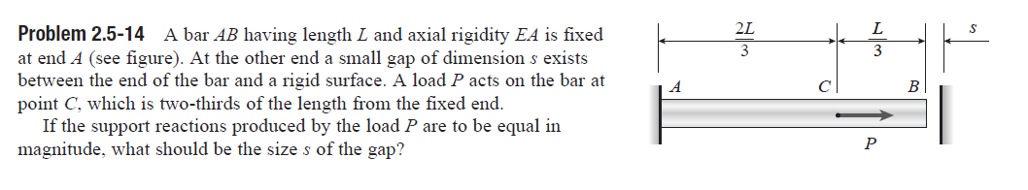
Problem 3
We will look at the problem again intuitively as well as analytically.

Slide 25
Problem 3
First the rod expands and just touches the wall
This expansion is due to P only.

Slide 26
Problem 3
The rod expands further and tries to penetrate the wall.
This is when the wall pushes back and applies a force to restrict its length to L+s. This contraction is not visible and is due to the combined action of P and the reactions from the walls (think the “alternative problem”)
R_{B}

Slide 27
Problem 3
We first solve the second part.
We start with the FBD.
R_{A}
R_{B}

Slide 28
Problem 3
Domain AC
R_{A}
F(x)
R_{B}

Slide 29
Problem 3
Domain CB
R_{A}
R_{B}
F(x)

Slide 30
Problem 3
The displacement of B can now be found.
We need to keep in mind that this is positive when it is towards the right as per our coordinate system.

Slide 31
Problem 3
We can now find R_{A}.
We need to bear in mind that there was already a positive displacement of s before this.
The two “positive” displacements should together produce a zero displacement at B.

Slide 32
Problem 3
As per the problem the reactions must be equal in magnitude.
In our convention that means R_{A} = - R_{B}.

